Slide 1

Notes:
1

Slide 2

Introduction
Block diagram
Power Supply
ARM7 TDMI
Serial communication
Max 232
RF communication
Vibration sensor
GSM
GPS
LCD
DC motor
Advantages
Conclusion

Slide 3

Security in travel is primary concern for every one. The uniqueness of this project is alerting the neighbors by its siren, but also it sends a caution SMS to four mobile numbers through GSM and GPS.

Slide 4

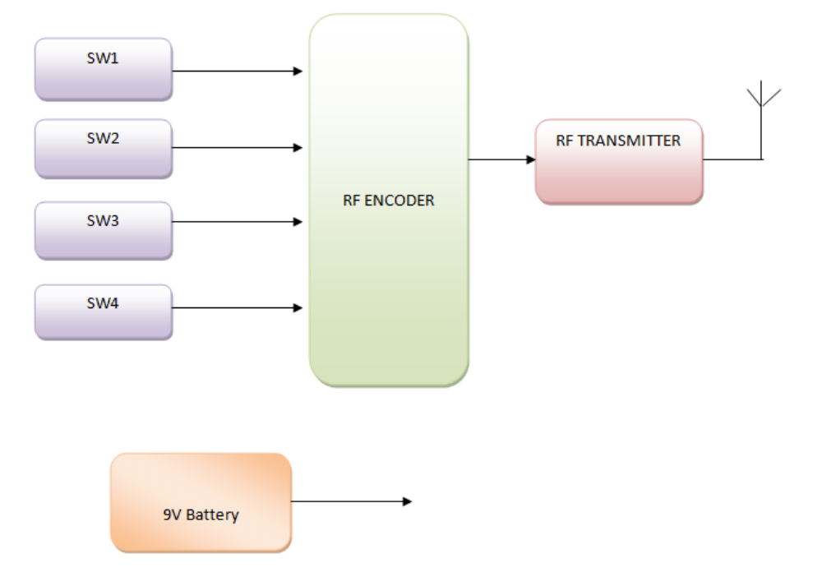

Slide 5
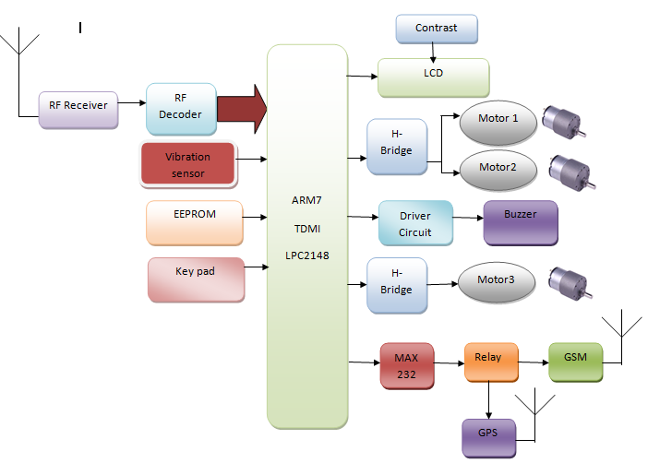
Receiver

Slide 6

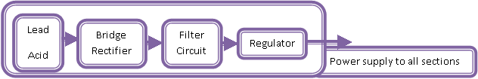
This project uses regulated 3V, 500mA power supply.
7805 three terminal voltage regulator is used for voltage regulation.
Bridge type full wave rectifier is used to rectify the ac out put of secondary of 230/12V step down transformer.

Slide 7

ARM7TDMI is an advanced version of microprocessors and forms the heart of the system.
.The LPC2148 are based on a 16/32 bit with real-time emulation and embedded trace support, together with 512 kilobytes of embedded high speed flash memory. A 128-bit wide memory interface and unique accelerator architecture enable 32-bit code execution at maximum clock rate.

Slide 8
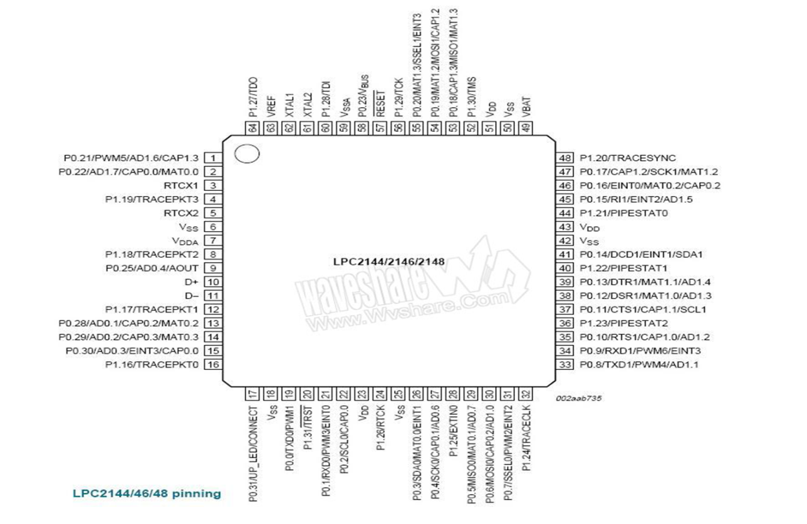
LPC 2148 CONTROLLER

Slide 9

For critical code size applications, the alternative 16-bit Thumb Mode reduces code by more than 30% with minimal performance penalty. With their compact 64 pin package, low power consumption, various 32-bit timers, 4- channel 10-bit ADC, USB PORT,PWM channels and 46 GPIO lines.
these microcontrollers are particularly suitable for industrial control, medical systems, access control and point-of-sale.
With a wide range of serial communications interfaces, they are also very well suited for communication gateways, protocol converters and embedded soft modems as well as many other general-purpose applications.
Notes:
1

Slide 10

Max232 IC is a specialized circuit which makes standard voltages as required by RS232 standards.
This IC provides best noise rejection and very reliable against discharges and short circuits. MAX232 IC chips are commonly referred to as line drivers.
Notes:
1

Slide 11

To ensure data transfer between PC and microcontroller, the baud rate and voltage levels of Microcontroller and PC should be the same. The voltage levels of microcontroller are logic1 and logic 0 i.e., logic 1 is +5V and logic 0 is 0V.
But for PC, RS232 voltage levels are considered and they are: logic 1 is taken as -3V to -25V and logic 0 as +3V to +25V. So, in order to equal these voltage levels, MAX232 IC is used. Thus this IC converts RS232 voltage levels to microcontroller voltage levels and vice versa.

Slide 12

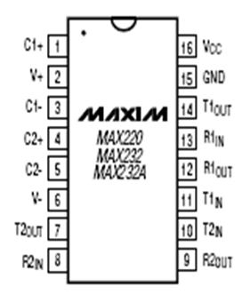

Slide 13

Radio frequency (RF) is a frequency or rate of oscillation within the range of about 3 Hz to 300 GHz. This range corresponds to frequency of alternating current electrical signals used to produce and detect radio waves. Since most of this range is beyond the vibration rate that most mechanical systems can respond to, RF usually refers to oscillations in electrical circuits or electromagnetic radiation

Slide 14
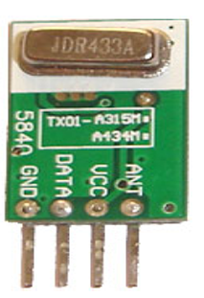


Slide 15

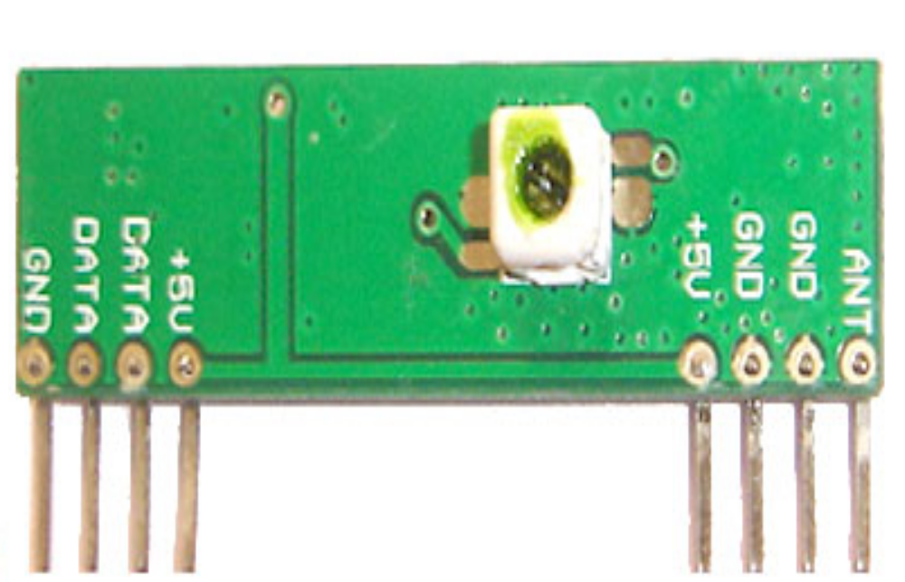

Slide 16

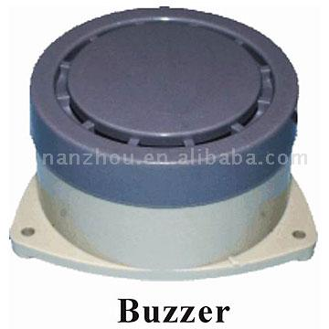
An electric coil is wound on a plastic bobbin, the latter having a central sleeve within which a magnetic core is slide ably positioned. One end of the sleeve is closed and projects beyond the coil. An inverted cup-shaped housing surrounds the coil and bobbin and has a central opening through which the closed end of the sleeve projects

Slide 17
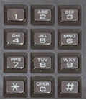

A keypad is a set of buttons arranged in a block or "pad" which usually bear digits and other symbols and usually a complete set of alphabetical letters. If it mostly contains numbers then it can also be called a numeric keypad.

Slide 18
Vibration sensor/Piezoelectric sensor
A piezoelectric sensor is a device that uses the piezoelectric effect, to measure changes in pressure, acceleration,strain or force by converting them to an electrical charge. The prefix piezo- is Greek for 'press' or 'squeeze'.

Slide 19
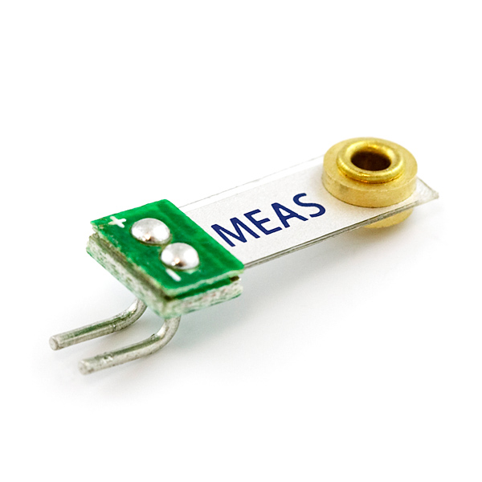
Vibration sensor

Slide 20
GSM
Global System for Mobile (GSM) is a second generation cellular standard developed to cater voice services and data delivery using digital modulation.

Slide 21
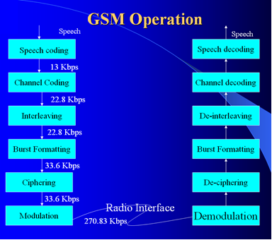

Slide 22

Global Positioning System (GPS) is a U.S. space-based global navigation satellite system. It provides reliable positioning, navigation, and timing services to worldwide users on a continuous basis in all weather, day and night, anywhere on or near the Earth which has an unobstructed view of four or more GPS satellites.

Slide 23

A liquid crystal display (LCD) is a thin, flat panel used for electronically displaying information such as text, images, and moving pictures.
Its uses include monitors for computers, televisions, instrument panels, and other devices ranging from aircraft cockpit displays, to every-day consumer devices such as gaming devices, clocks, watches, calculators, and telephones.

Slide 24
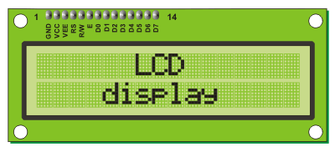
Among its major features are its lightweight construction, its portability, and its ability to be produced in much larger screen sizes than are practical for the construction of cathode ray tube (CRT) display technology.

Slide 25
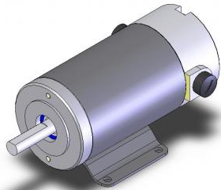

In any electric motor, operation is based on simple electromagnetism. A current-carrying conductor generates a magnetic field; when this is then placed in an external magnetic field, it will experience a force proportional to the current in the conductor, and to the strength of the external magnetic field.
Every DC motor has six basic parts -- axle, rotor (armature), stator, commutator, field magnet's, and brushes. In most common DC motors the external magnetic field is produced by high-strength permanent magnets.

Slide 26

Ease of operation
Low maintenance cost
Fit and forget system
No wastage of time
Durability
It gives immediate information to the Ambulance
Simple and reliable

Slide 27

A design of effective alarm system that can monitor an automotive / vehicle / car condition in traveling. This project is designed to inform about an accident that is occurred to a vehicle to the family members of the traveling persons. When the accident occurs, the vibration sensor is activated then automatically vehicle door opens. Also a message is sent to the pre-stored numbers with location.

Slide 28
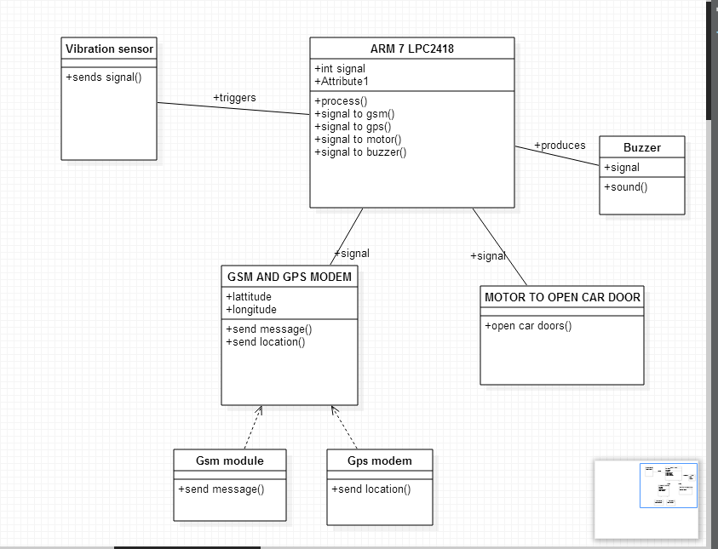

Slide 29
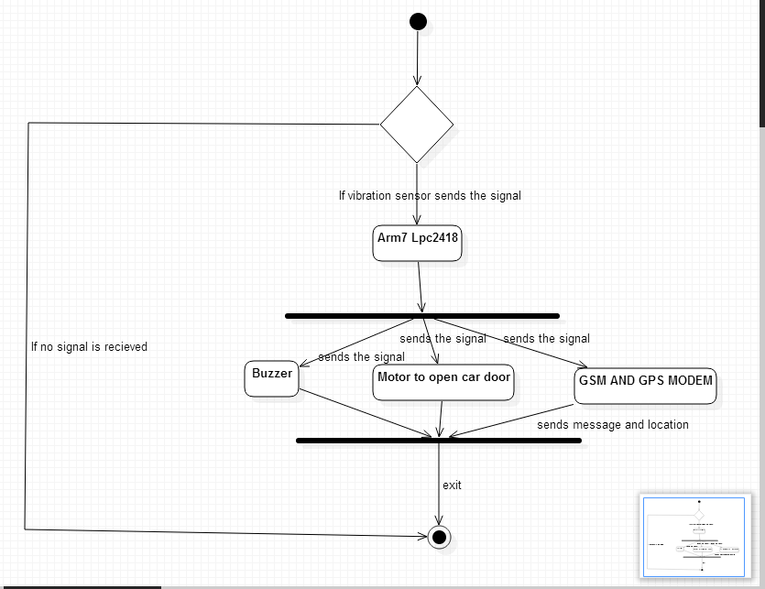

Slide 30
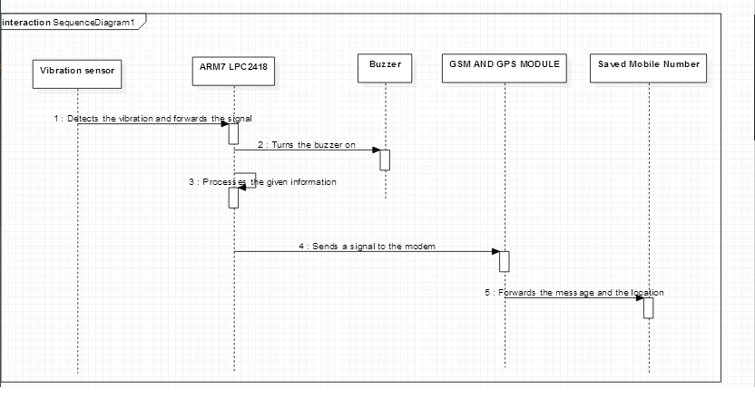

Slide 31
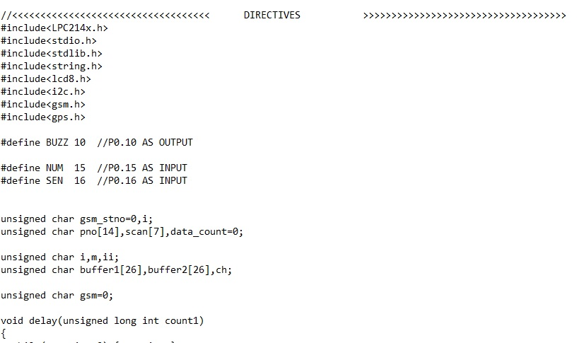

Slide 32
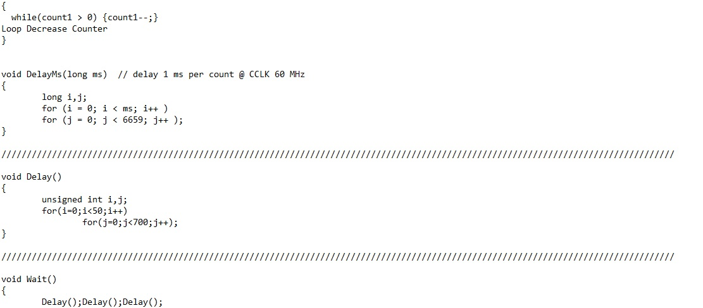

Slide 33
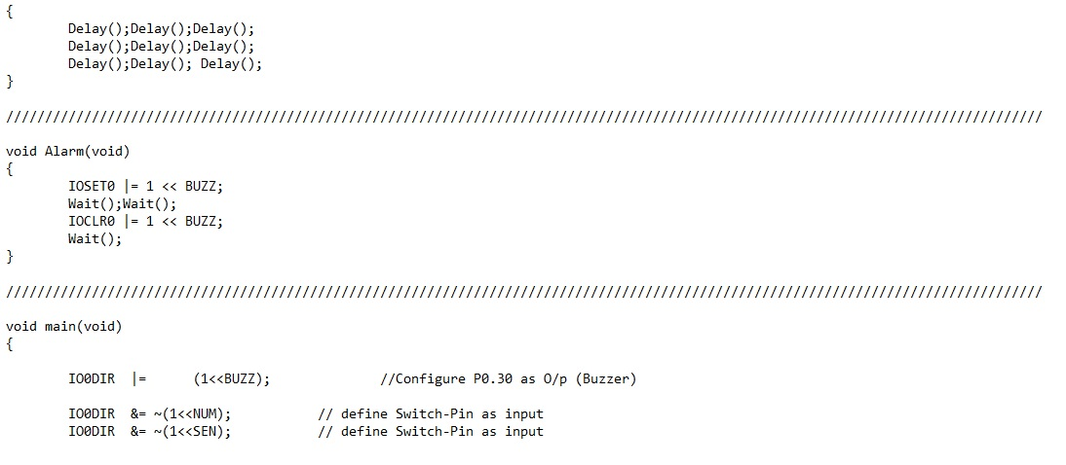

Slide 34
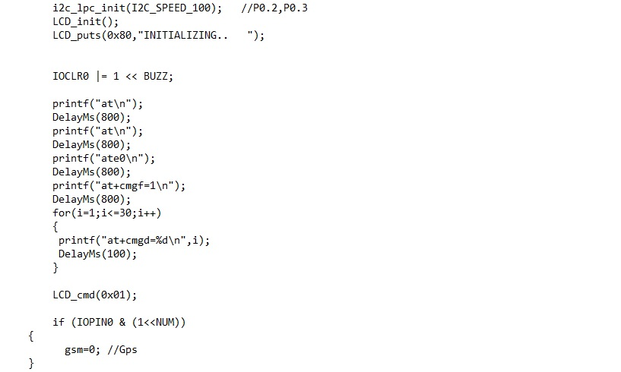

Slide 35
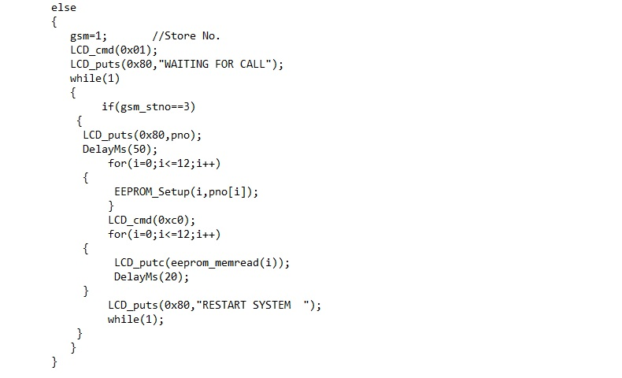

Slide 36
